Slide 1

Convolutional Neural Networks (VGG-16)
Presentation 3

Slide 2
OUTLINE
Introduction
History
Architecture
Applications
Practical example

Slide 3
Introduction
A convolutional neural network is a feed-forward neural network that is generally used to analyze visual images by processing data with grid-like topology.
It’s also known as a ConvNet.
A convolutional neural network is used to detect and classify objects in an image.
In simple words, A Convolutional neural network (CNN) is a neural network that has one or more convolutional layers and are used mainly for image processing, classification, segmentation and also for other auto correlated data.

Slide 4
Introduction
Wait a sec !!!
We already discussed neural networks right!!
So what changed?

Slide 5
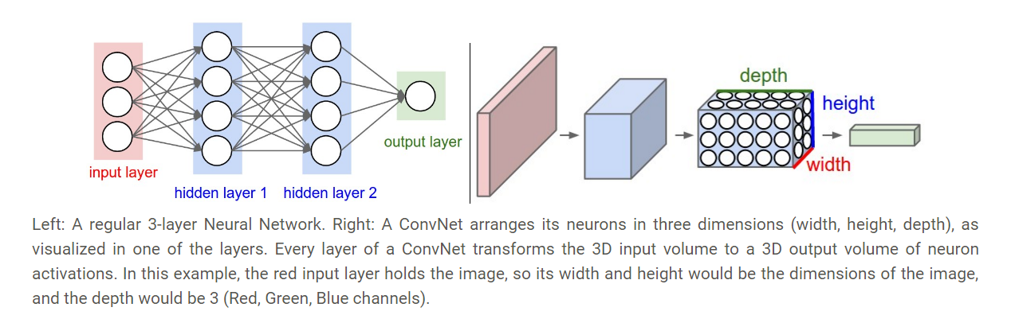
Introduction
Neural network Vs Convolutional neural network

Slide 6
Introduction
A convolution is essentially sliding a filter over the input.
Types:
In simple terms a large enough CNN can solve any solvable problem.
Notable CNN architecture’s that perform exceptionally well across many different image processing tasks are the VGG ( Visual Geometry Group) models ( K. Simonyan and A. Zisserman),
The ResNet models (Kaiming He et al) and
The Google Inception models (Christian Szegedy et al). These models have millions of trainable parameters.

Slide 7
History
In 1959, David Hubel and Torsten Wiesel described “simple cells” and “complex cells” in the human visual cortex. They proposed that both kinds of cells are used in pattern recognition.
Inspired by Hubel and Wiesel’s work, in the 1980s, Dr. Kunihiko Fukushima designs an artificial neural network that mimics the functioning of simple and complex cells.
Although the work of Fukushima was very powerful in the newly developing field of artificial intelligence, the first modern application of convolutional neural networks was implemented in the 90s by Yann LeCun et al. in their paper Gradient-Based Learning Applied to Document Recognition.
In the paper, he trained a cnn with the MNIST dataset of handwritten digits. LeCun’s implementation set the standards for today’s computer vision and image processing applications.
The 90s, onwards are the years where the streamlined process of building convolutional neural networks was used for more and more complex models trained on larger and larger datasets.

Slide 8
History
In 2005, the PASCAL VOC challenge -where the participants compete to achieve the lowest loss + highest accuracy performance with their model- started with approximately 20,000 images and 20 object classes.
However, with the advancements in the field, these numbers were dwarfed by other private studies.
Starting from 2010, Fei-Fei Li started collaborating with the PASCAL VOC team to make a very large image dataset available with the name, ImageNet.
Every year researchers were invited to the ImageNet Large Scale Visual Recognition Challenge (ILSVRC).
In 2012, a deep convolutional neural network architecture called AlexNex achieved a 16% error rate (10% lower than the runner-up) by utilizing GPUs.
The use of GPUs for computer vision tasks became standard after AlexNext’s incredible achievement for its time.
In 2017, 29 of 38 competing teams at the ILSVRC achieved less than 5% error.

Slide 9
History (VGG)
The runner-up in ILSVRC 2014 was the network from Karen Simonyan and Andrew Zisserman that became known as the VGGNet. Its main contribution was in showing that the depth of the network is a critical component for good performance.
VGG-16 model was named by Karen Simonyan and Andrew Zisserman after their Visual Geometry Group Lab of Oxford University.
Their final best network contains 16 CONV/FC layers and, appealingly, features an extremely homogeneous architecture that only performs 3x3 convolutions and 2x2 pooling from the beginning to the end.
This achieves 92.7% test accuracy on the ImageNet dataset.

Slide 10
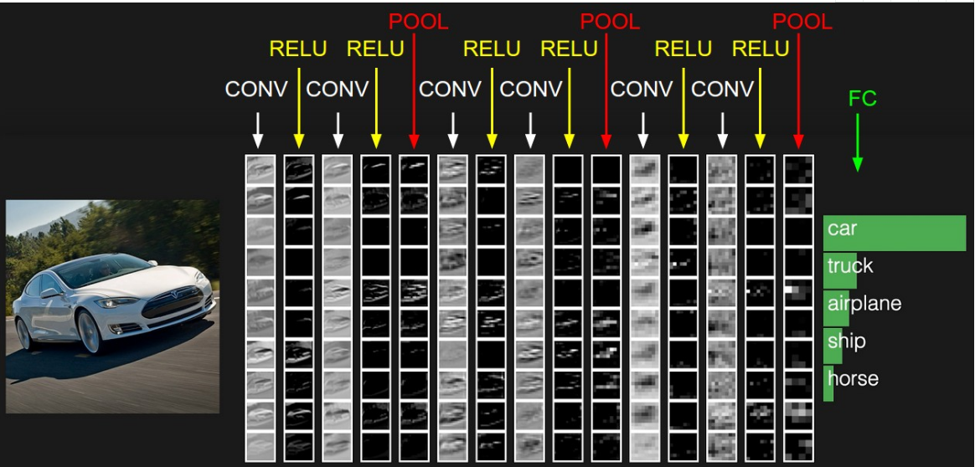
Architecture
CNN
CONV: Convolutional kernel layer
RELU: Activation function
POOL: Dimension reduction layer
FC: Fully connection layer

Slide 11
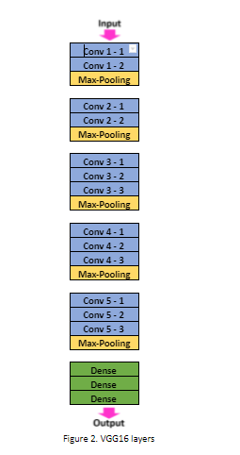

Architecture (VGG)

Slide 12
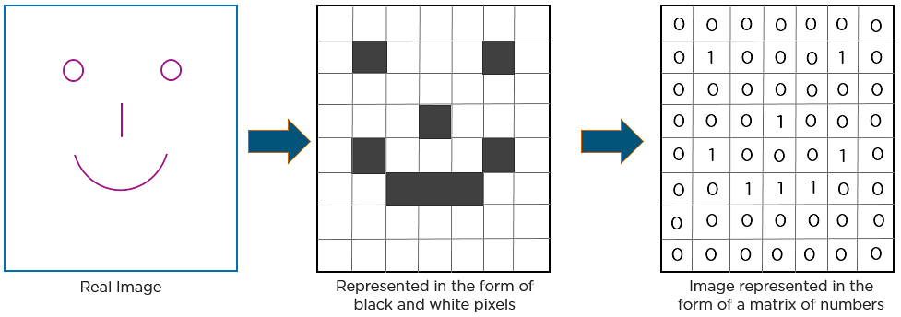
Architecture
How CNN recognizes an image?

Slide 13
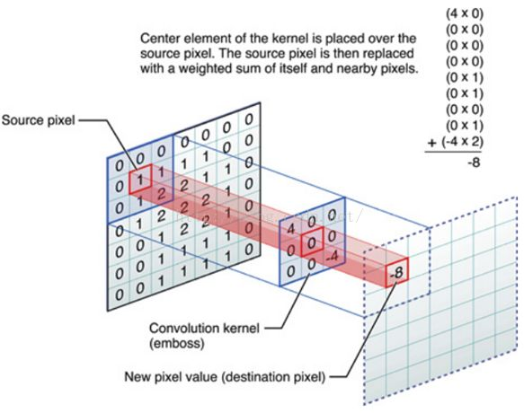
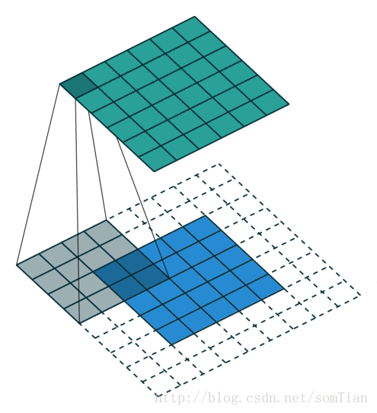
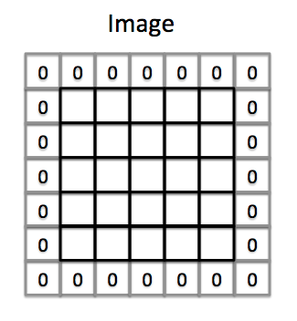
Convolutional kernel
How Convolutional kernel works?
Padding on the input volume with zeros in such way that the conv layer does not alter the spatial dimensions of the input

Slide 14
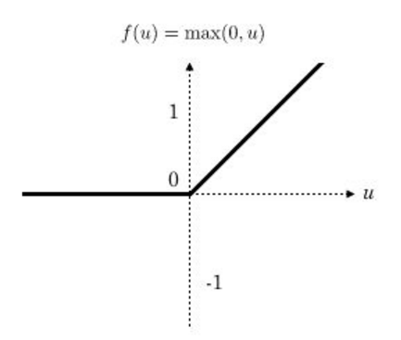
Rectified linear unit，ReLU
Returns 0 for negative values.

Slide 15
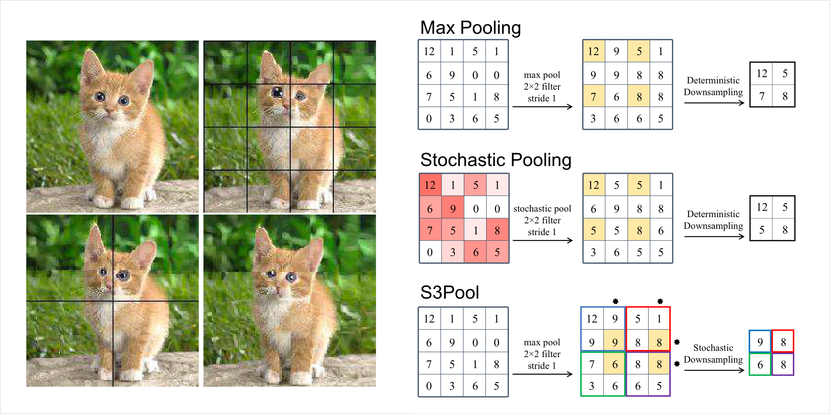
Pooling layer Pooling is a down-sampling operation that reduces the dimensionality of the feature map.

Slide 16
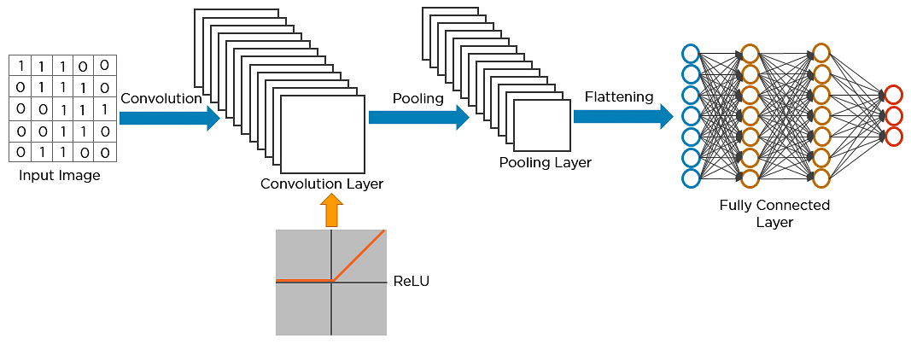
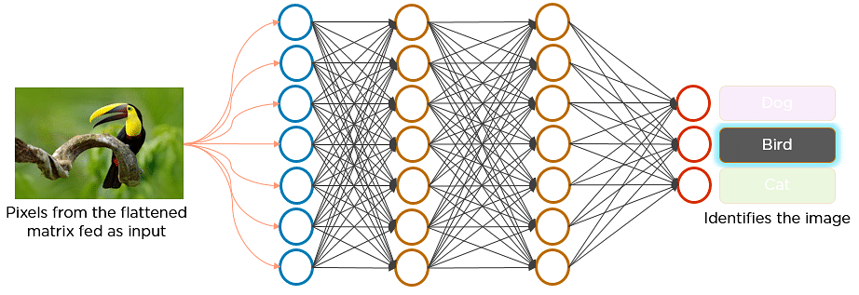
Architecture

Slide 17
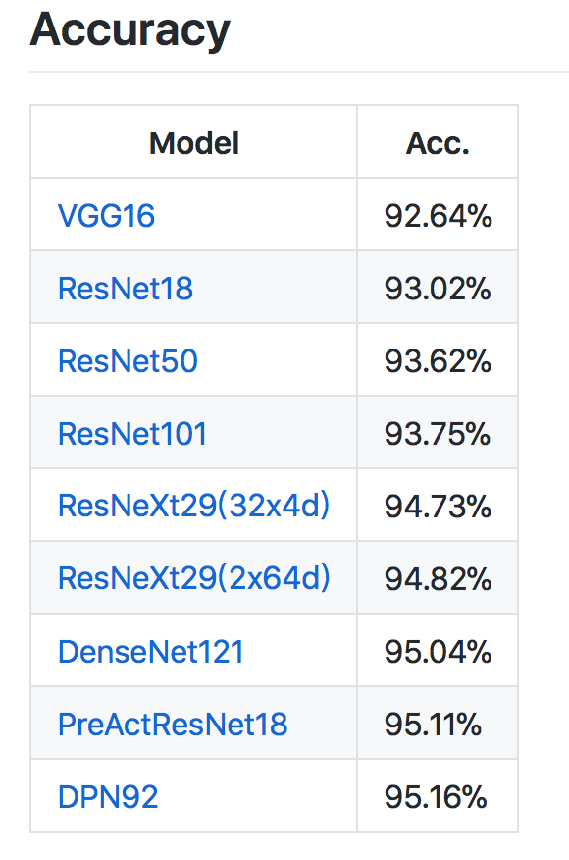
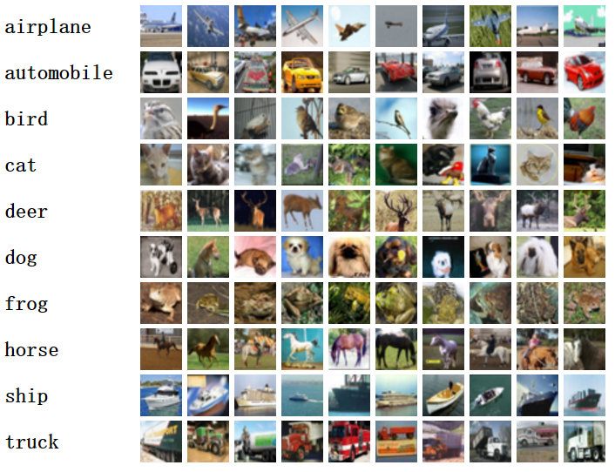
CIFAR10 dataset and state of the art
The CIFAR-10 dataset consists of 60000 32x32 color images in 10 classes,
with 6000 images per class. There are 50000 training images and 10000 test images.

Slide 18
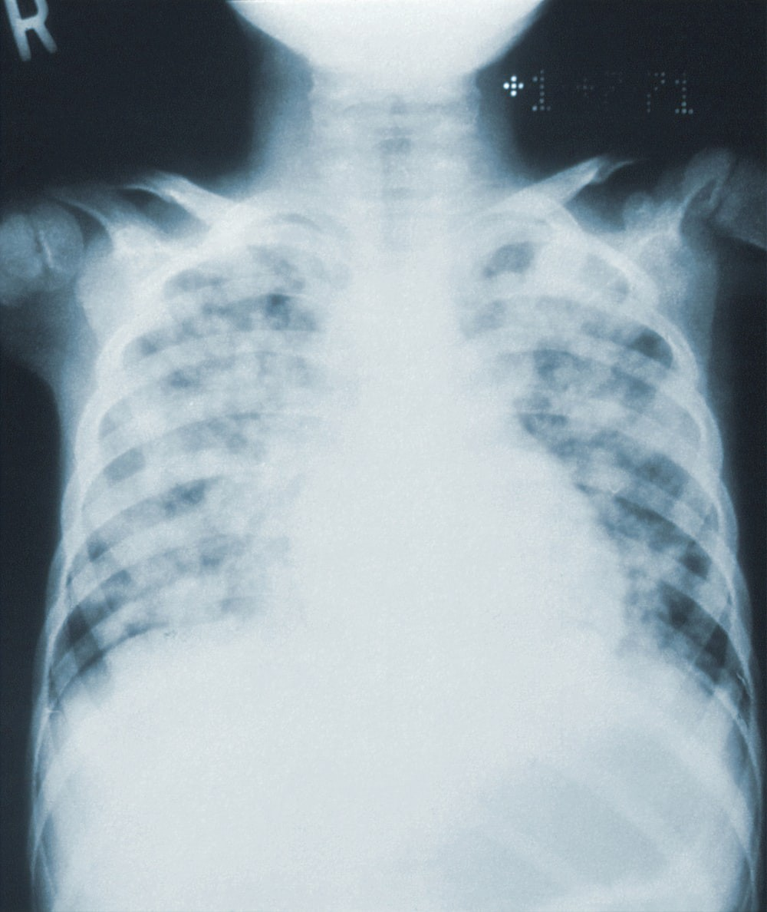
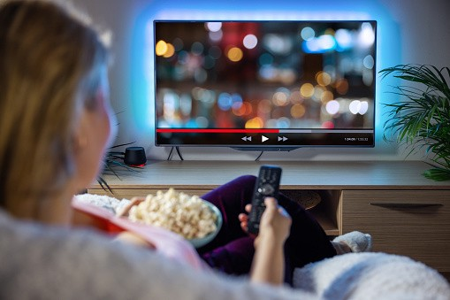
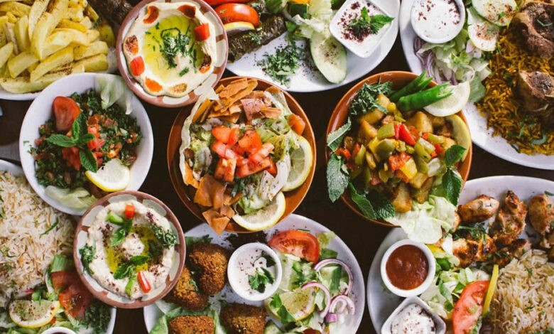
Applications
PNEUMONIA DETECTION THROUGH X-RAY IMAGES – With the help of the VGG-16 model, we can analyze and diagnose pneumonia by scanning the x-ray images, showing the chest ribs and area whether affected or not. This will help doctors in diagnosis and making correct precautions needed to be taken necessarily.
MOVIES - The idea is to check movies and take out more information that makes the user experience more interactive and become their prime solution.
Foods - With help of this model, big datasets of food cuisines all over the world can be identified and classified whether it’s oriental, thai, Desi, Chinese, Lebanese or Fast food.

Slide 19
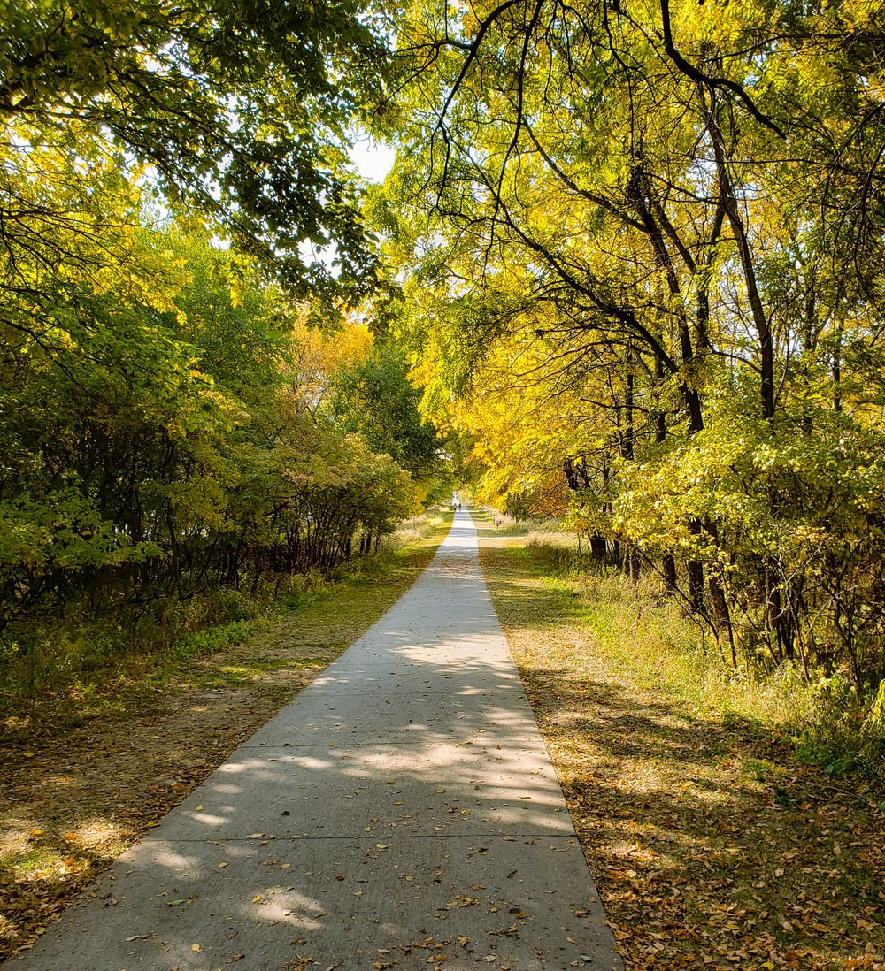
Applications
Find path – Finding paths with the help of this Artificial Convolutional Neural Network lets us help and find human paths and routes, such as sidewalks, parkways, forest paths.

Slide 20
Limitations
A downside of the VGGNet is that it is more expensive to evaluate and uses a lot more memory and parameters (140M).
Most of these parameters are in the first fully connected layer, and it was since found that these FC layers can be removed with no performance downgrade, significantly reducing the number of necessary parameters.

Slide 21
Practical Example
Classification of cats vs dogs:
cats_and_dogs_filtered dataset is used.
Link to dataset:
https://www.kaggle.com/datasets/birajsth/cats-and-dogs-filtered
Train data:
Found 2000 images belonging to 2 classes.
Test data:
Found 1000 images belonging to 2 classes.

